Slide 1
Web Scraping ‘Selenium’ {
HTML.html
intro.css
[Dynamic Websites]
< Week 3>
}
CS Job Market Overview

Slide 2
00 {
[Dyanmic Websites]
project.html
intro.css
< Quick intro dynamic websites >
}
CS Job Market Overview

Slide 3
The Grand Divide ‘Websites’ {
01
02
overview.html
contents.css
HTML Basics
< Dynamic website >
Libraries
< Static website >
}
CS Job Market Overview

Slide 4
01 {
[Difficulties]
difficulties.html
intro.css
< Oh no… >
}
CS Job Market Overview

Slide 5
Variety < /1 > {
intro.html
blocks.css
Each website is unique! So many diversities in < layouts>, <styles>, <content>, <data structures>
}
Longevity < /2 > {
Web pages can and will change.
}
CS Job Market Overview

Slide 6
Scalability < /3 > {
intro.html
blocks.css
As our data increases, so does our performance.
}
Anti-bots < /4 > {
< IP blockers >
< JavaScript Challenges >
< CAPTCHAS >
}
CS Job Market Overview

Slide 7
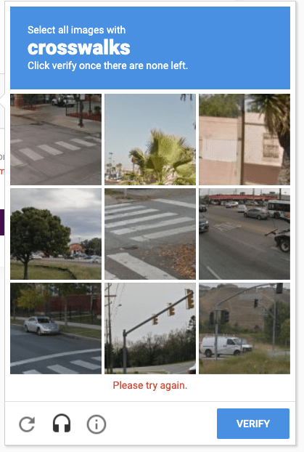
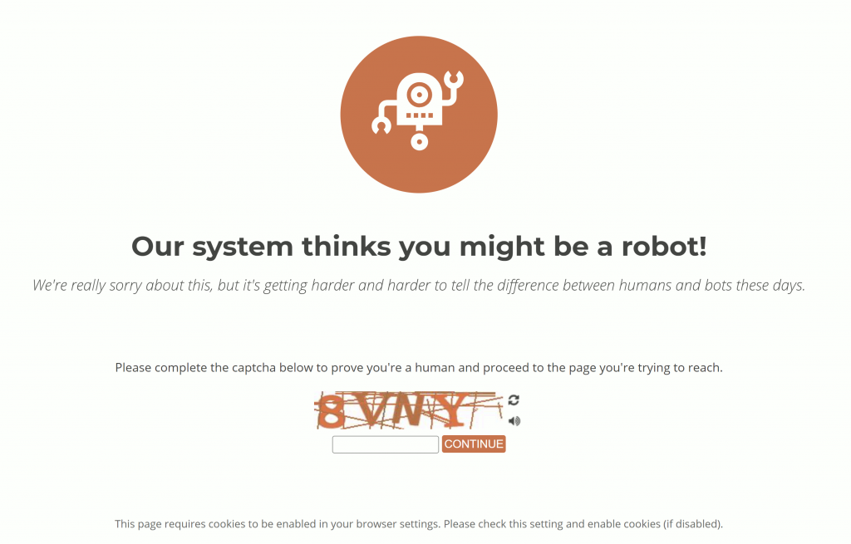
A ‘Picture’ Is { Worth a Thousand Words
}

Slide 8



Slide 9
02 {
[Selenium]
python.html
libraries.css
< import selenium >
}
CS Job Market Overview

Slide 10

Selenium {
python.html
libraries.css
Import selenium.webdriver as webdriver
}
But what is a webdriver?
CS Job Market Overview

Slide 11
03 {
[Webdriver]
python.html
libraries.css
< import selenium.webdriver as webdriver >
}
CS Job Market Overview

Slide 12
Web driver {
python.html
selenium.css
Remote control interface of browsers.
< Control the browser itself >
< Enable selection of web elements >
< Debugging aid >
}
For more information: Webdriver
CS Job Market Overview

Slide 13
Supported Drivers {
python.html
selenium.css
< Chrome >
< Edge >
< Firefox >
< Internet Explorer >
< Safari >
}
For more information: Webdriver
CS Job Market Overview

Slide 14
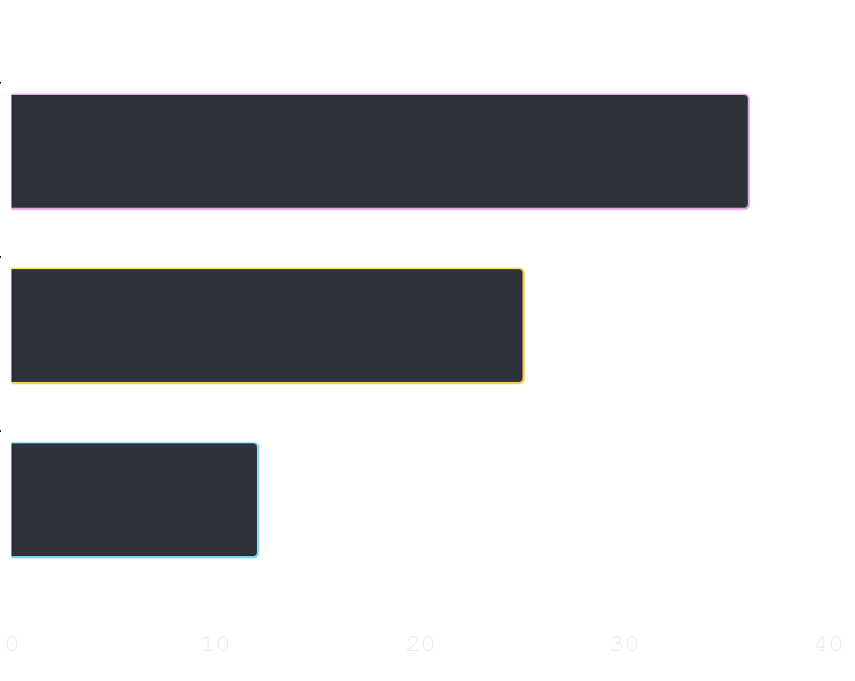
Steps to get ‘started’! {
libraries.html
selenium.css
Import selenium
First Step
Set up your driver
Second Step
Scraping
Last step
}
CS Job Market Overview

Slide 15
Common Imports {
python.html
selenium.css
import selenium.webdriver as webdriver
from selenium.webdriver.chrome.service import Service
from selenium.webdriver.common.by import By
}
Imports for chrome.
CS Job Market Overview

Slide 16
Set up driver {
python.html
selenium.css
chrome_driver = “../chromedriver.exe”
chrome_options = webdriver.ChromeOptions()
driver = webdriver.Chrome(service=Service(chrome_driver), options=chrome_options)
}
Imports for chrome.
driver.get(“url goes here”)
CS Job Market Overview

Slide 17
Let’s { Practice;
requets.html
practice.css
}
CS Job Market Overview

Slide 18

libraries.html
selenium.css
CS Job Market Overview

Slide 19
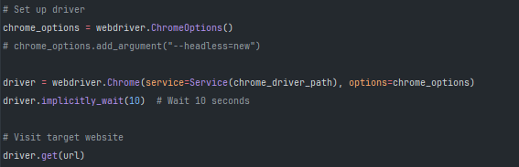
libraries.html
selenium.css
CS Job Market Overview

Slide 20
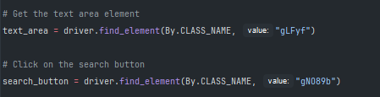
libraries.html
selenium.css
CS Job Market Overview

Slide 21

libraries.html
selenium.css
CS Job Market Overview

Slide 22
find.element() or find.elements()
libraries.html
selenium.css
By.CSS_SELECTOR | Select element that matches CSS selector
By.CLASS_NAME | Select element based on their class attribute
By.ID | Select element based on their ID attribute
By.XPATH | Select an element that matches xpath expression
By.LINK_TEXT | Select an anchor tag matching a specific text
By.PARTIAL_LINK_TEXT | Select an anchor that matches the substring of a link text
By.TAG_NAME | Select element based on their tag name
CS Job Market Overview

Slide 23
04 {
[Infinite Scroll]
python.html
selenium.css
< Page height, time.sleep >
< resource >
}
CS Job Market Overview

Slide 24
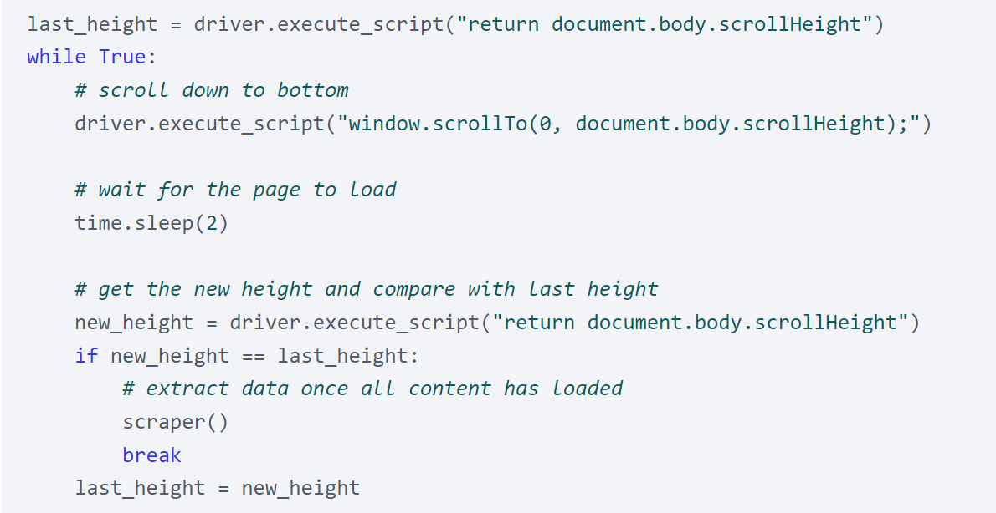
libraries.html
requests.css
CS Job Market Overview

Slide 25
05 {
[Buttons]
python.html
selenium.css
< .click() >
}
CS Job Market Overview

Slide 26
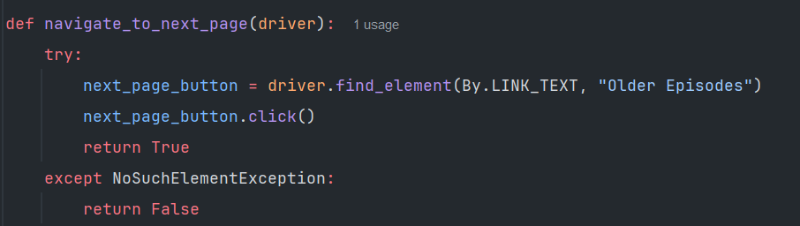
libraries.html
selenium.css

Slide 27
Still getting blocked { What now?;
selenium.html
HELP!!!!.css
}
CS Job Market Overview

Slide 28
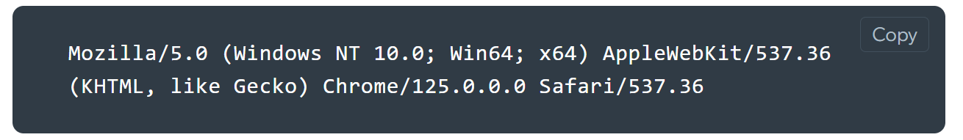
< Masking IP with proxies> {
python.html
Avoid-detection.css
Proxies protects your IP address and avoid blocks when scraping websites like Amazon, LinkdIn, etc.
}
Rotating user Agent{
Driver browsers have a default parameters. By rotating it can help go through some blocks.
}
CS Job Market Overview

Slide 29

< Avoid Patterns> {
python.html
Avoid-detection.css
By randomizing time frames, using waits, scrolling slower, or just trying to mimic human behavior can help avoid bot detectors
}
Using selenium-stealth{
Python package to help prevent detection
}
CS Job Market Overview

Slide 30
Thanks; {
python.html
ThankYou.css
‘Do you have any questions?’
Shoot me a message on discord
@Barderus
< Please keep this slide for attribution >
}
CS Job Market Overview

Slide 31
Job Postings websites:
Joblist
Indeed
USAJobs
Monster
Simplyhired
LinkUp
Glassdoor
Zip recruiter
LinkedIn

